Slide 1
Phone Marketing Decision Model for Retail Banking
Turning Data into Insights
LARA ZEFANI
I developed a classification model that will further refine the bank's ability to predict customer behavior. This model will enable the bank to make data-driven decisions regarding its phone marketing strategy, ensuring that resources are allocated efficiently and effectively. As a result, the bank will be able to optimize its calling strategy based on the insights generated from my analysis.
HTTPS://WWW.LINKEDIN.COM/IN/LARAZEFANI/

Slide 2
COLLECT DATA
1
Analysis Process
CLEAN DATA
2
ANALYZE DATA
3
5 Key Steps to Analyze Data
I start with data collection from Kaggle, ensuring accuracy and completeness for reliable analysis. Next, I perform data cleaning, handling inconsistencies and missing values. Then, I analyze the data using machine learning to uncover patterns and trends. After that, I focus on data interpretation, extracting insights and validating hypotheses. Finally, I use data visualization through charts and dashboards to present findings clearly, enabling stakeholders to make informed decisions. Each step is crucial for effective data-driven insights.
INTERPRET RESULTS
4
VISUALIZE FINDINGS
5

Slide 3



Tools for Analysis

Slide 4
Load The Dataset
https://www.kaggle.com/datasets/henriqueyamahata/bank-marketing

Slide 5

What is being classified?
Subscribe vs. Do Not Subscribe
The classification model is predicting whether a customer will subscribe or not subscribe to the bank's offer based on their behavior, helping optimize the phone marketing strategy.

Slide 6
Train the Classification Model
Random Forest Classification with Scikit-Learn
The Random Forest algorithm works by creating a multitude of decision trees during the training phase. Each tree is constructed using a random subset of the data and a random subset of features. This randomness introduces variability among individual trees, reducing the risk of overfitting and improving overall prediction performance.

Slide 7
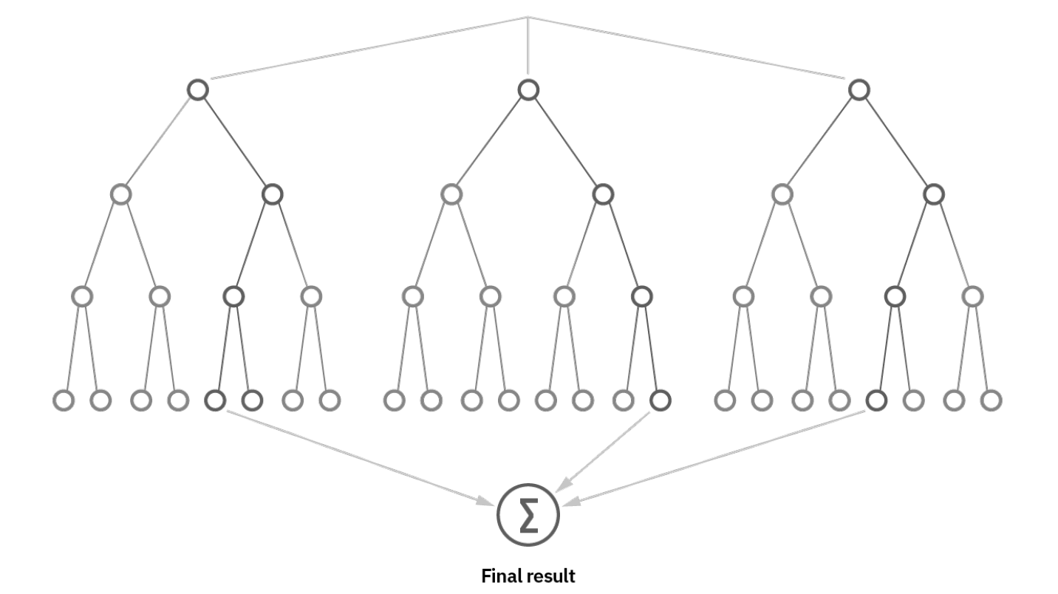
Classification Report
Accuracy: 0.89 Precision: 0.52 Recall: 0.28 F1-Score: 0.36
ROC-AUC: 0.62

Slide 8
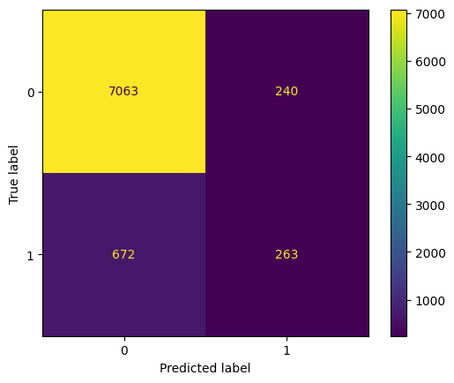
Confusion
Matrix
Confusion Matrix
True Negative (TN): Model correctly predicted 7063 customers who did not engage (0) as not interested.
False Positive (FP): Model incorrectly predicted 240 customers as interested (1) when they actually did not engage (0).
False Negative (FN): Model missed 672 customers who were actually interested (1), predicting them as not interested (0).
True Positive (TP): Model correctly identified 263 customers who engaged (1) as interested.

Slide 9
Decision Tree of The Model
You can access the full image of the decision tree of the model by clicking the link below:
https://github.com/larazefani/Phone-Marketing-Decision-Model-for-Retail-Banking/blob/main/random_forest_tree.pdf

Slide 10

Feature Importance Analysis
Why?
To understand which features contribute the most to the overall model decision-making.

Slide 11
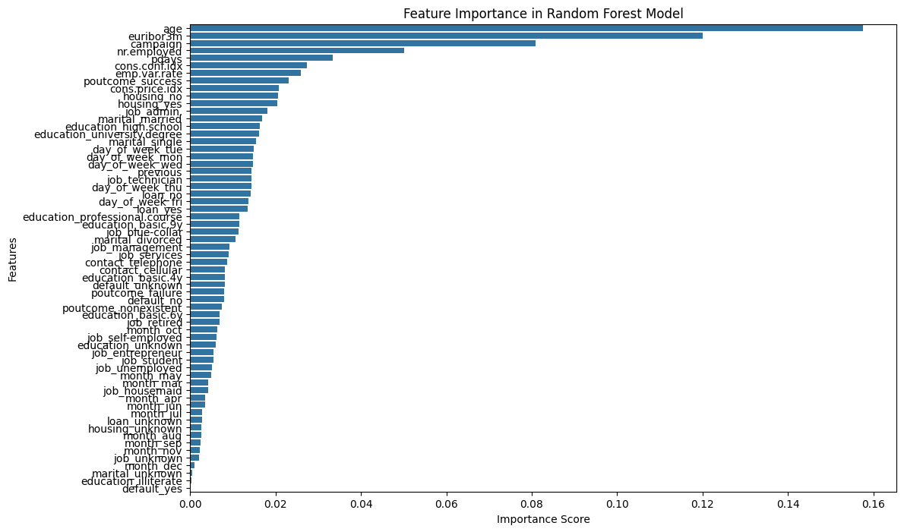

Slide 12
Feature Importance Analysis
Explanation
Age is the most important feature: It has the highest importance score, suggesting it strongly influences the model's predictions.
Other significant features: Other features with relatively high importance scores include "euribor3m", "campaign", "nr.employed", and "poutcome_success". This indicates that factors like interest rates, marketing campaign involvement, employment rates, and past outcome of contact attempts are also crucial for the model.
Features with low importance: Features at the bottom of the chart have low importance scores. They likely have minimal impact on the model's predictions.

Slide 13
Thankyou
LARA ZEFANI
Unlock the Power of Data!
HTTPS://WWW.LINKEDIN.COM/IN/LARAZEFANI/

